Slide 1

Credit EDA Case Study
Dyutimaya DAS
ShRUTI SRIVASTAVA

Slide 2
Table of Contents
Business Objectives
Case study - Data Set
Application Data
Loading the Data Set
Data Inspection
Data Cleaning
Handling Missing values
Checking for Outliers
Removing Columns irrelevant to the analysis
Binning Data
Checking Data imbalance
Univariate Analysis (Unordered) - Categorical variables
Univariate Analysis (Ordered) - Categorical variables
Univariate Analysis of Continuous variables
Segmented Analysis
Outlier Detection
Bivariate analysis
Multivariate analysis
Previous application Data
Loading the Data Set
Data Inspection
Merging with Application Data
Univariate analysis
Bi-variate analysis
Conclusion/Inference

Slide 3
Business Objectives
Identify Patterns indicating clients facing difficulty paying their loans. (this will help in denying the loan, reducing the loan amount, increasing the interest rate)
Consumers capable of repaying the loan is NOT REJECTED
Consumers incapable of repaying the loan are REJECTED
Driving factors/variable behind the loan default.
Identify and handle missing data
Identify outliers
Identify the data imbalance

Slide 4
Dataset :
ApplicationData - contains all the information of the client at the time of application. The data is about whether a client has payment difficulties.
Previous_application contains information about the client’s previous loan data. It contains the data whether the previous application had been Approved, Cancelled, Refused or Unused offer.
Columns_description is data dictionary which describes the meaning of the variables.

Slide 5
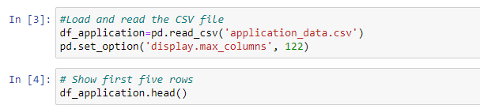
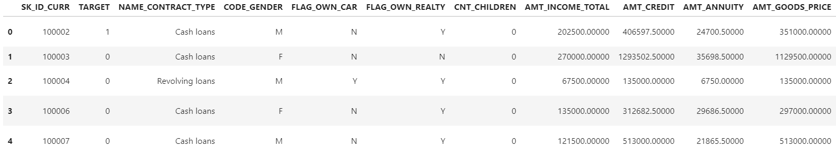
Loading the Application Data using the read_csv command in pandas

Slide 6
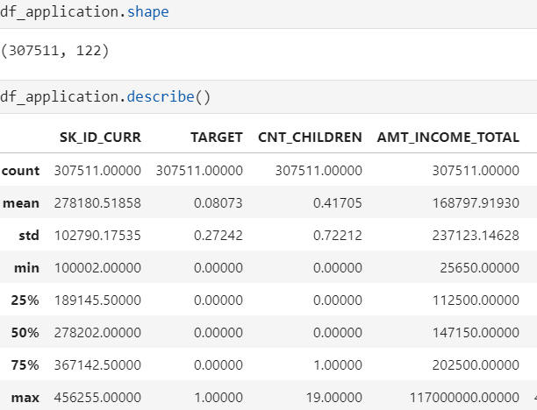
Application Data Inspection
Using functions like shape, describe to get a view of the data along with some statistical information.

Slide 7

Handling Missing values – Check the null values using the isnull python function and drop the columns with more that 50% of missing data.
Checking for Outliers - Use the describe and box plot function to check the presence of outliers.
Removing Columns irrelevant to the analysis – Based on the understanding of the data columns description remove the columns which are not important for our analysis.
Binning Data – Use the qcut function to put data into bins for easier analysis (AGE, INCOME_RANGE)
Missing Data, outliers can reduce the statistical power of a study and can produce biased estimates, leading to invalid conclusions.
Data Cleaning

Slide 8
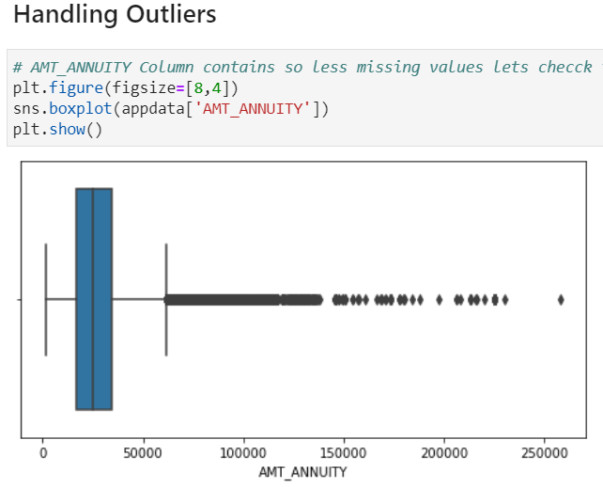
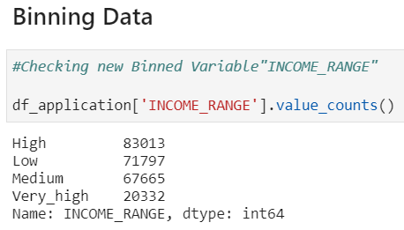
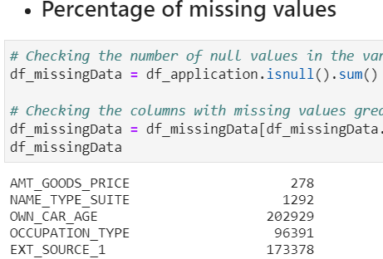
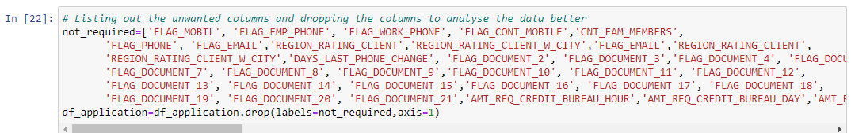
Data Cleaning

Slide 9
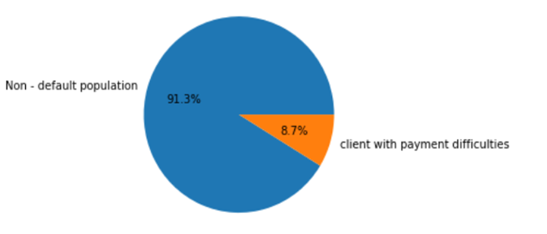
Data Imbalance
Splitting the application data set into two based on the TARGET variable, we notice that there is high imbalance between the defaulters and non-defaulters.
The ratio of data imbalance is approx. 10.50
Defaulters: Client with Payment Difficulties
Non-Defaulters – all others in the population.

Slide 10
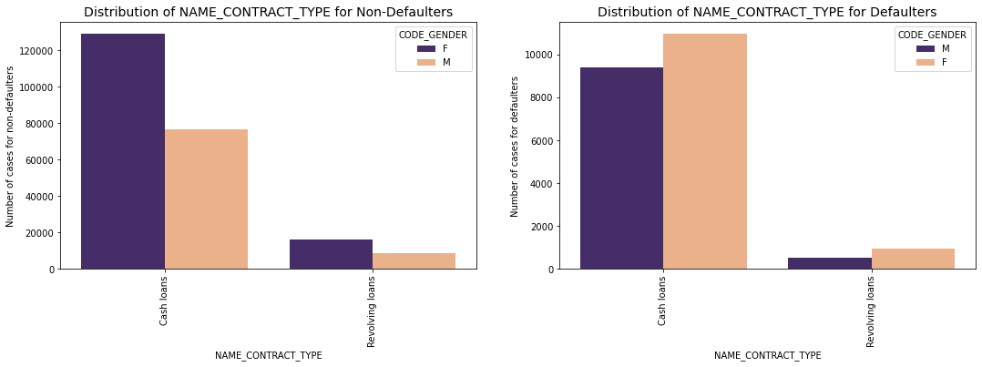
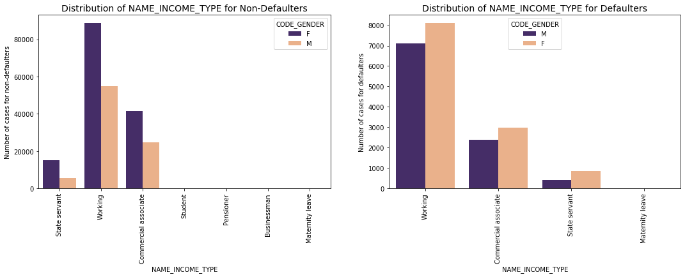
Univariate Analysis – Unordered Categorical Variables
NAME_CONTRACT_TYPE :
Revolving loans are lesser in the defaulted population.
Comparing both the plots it seems like the percentage of male for cash loans in defaulters are more than that of others
NAME_INCOME_TYPE :
Most of the defaulters are in the working population, the reason may be this income_type apply for more loans
Most of the defaulters are female and belongs to working type.

Slide 11
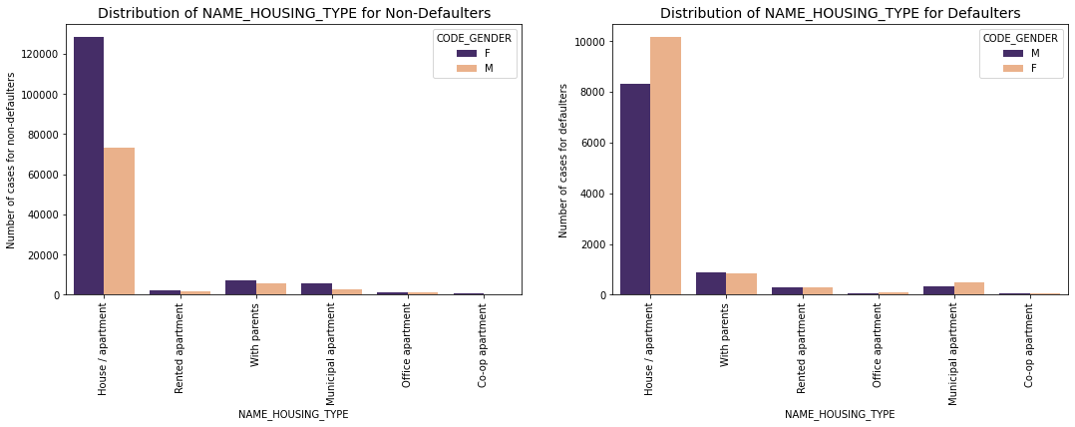
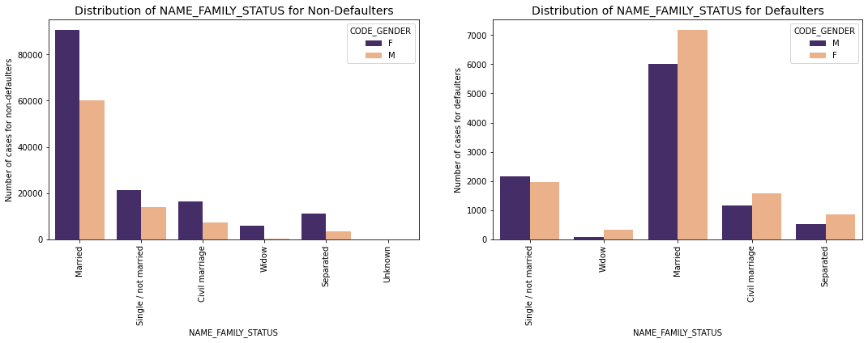
Univariate Analysis – Unordered Categorical Variables
Name Housing Type:
Population living in Rented apartments and those living with parents have higher default rate as they have higher proportion in the Defaulted population as compared to non defaulted population.
Living in rental apartment means a cash outflow towards rent and thus less cash left for repayment of loan. Living with parents may suggest that the income is not too high and thus difficulty in repayment of loan.
Name Family Status:
Single male applicants have comparatively more defaulters than the female applicants
Married male are more no. of defaulters in percentage than the married female

Slide 12
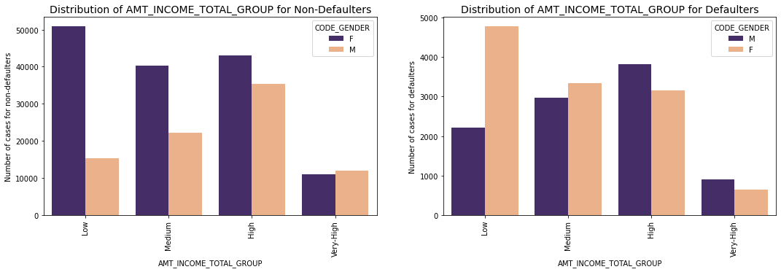
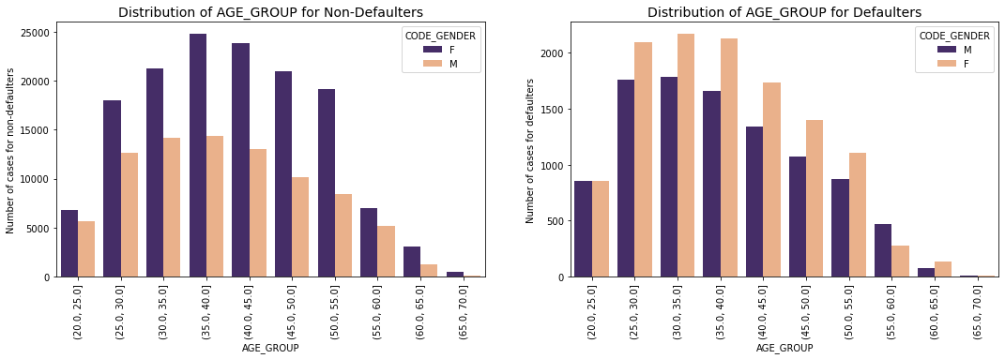
Univariate Analysis – Ordered Categorical and Continuous Variables
AMT_INCOME_TOTAL_GROUP : Low income have higher defaults
AGE_GROUP : Middle aged have higher number of defaulters

Slide 13
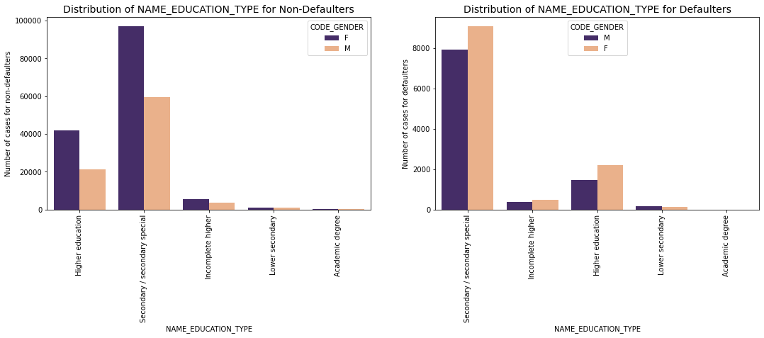
Univariate Analysis – Ordered Categorical Variables
Name Education Type:
Defaults from the clients with Academic degree are quite low.
Approving application from clients having secondary/secondary special is a risk as they have more defaults. The no. of female defaulters is more than that of males.
Clients having secondary/secondary special took more loan as compared to others.

Slide 14
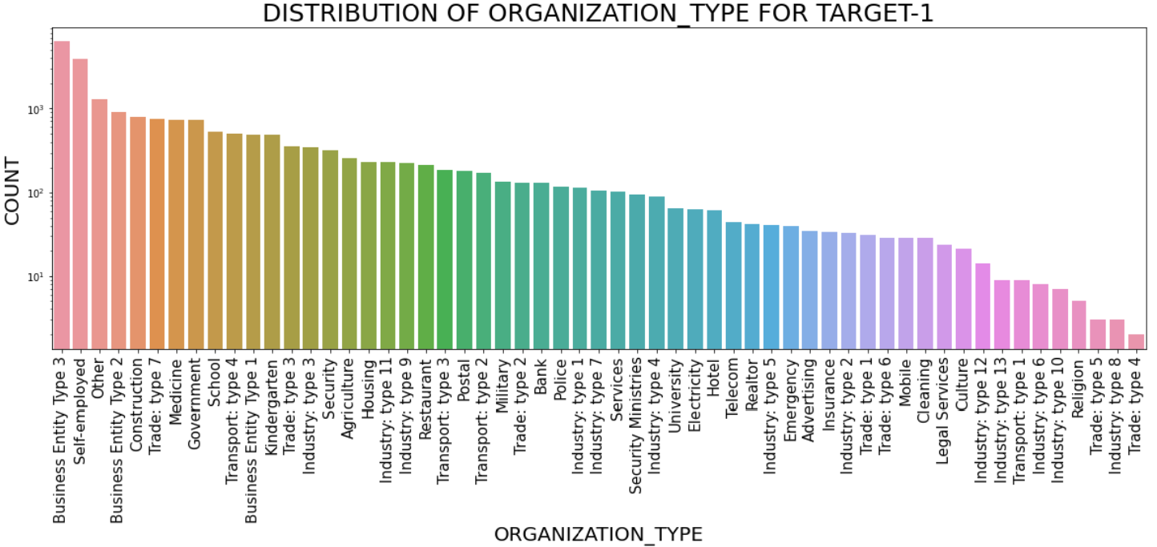
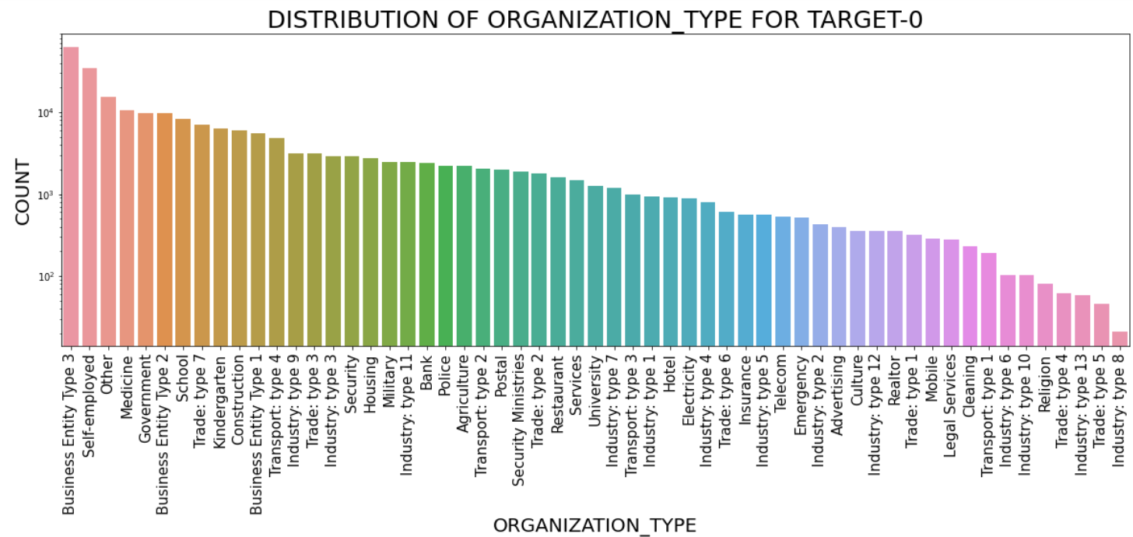
DISTRIBUTION PLOT OF ORGANIZATION_TYPE FOR TARGET 0 AND 1
Defaulters (Target 1):
Clients which have applied for credits are from most of the organization type ‘Business entity Type 3’ , ‘Self employed’ , ‘Other’ , ‘Medicine’ and ‘Government’.
Less clients are from Industry type 8,type 6, type 10, religion and trade type 5, type 4.
Non-Defaulters(Target 0):
Most of the clients who have applied for credits are from "Business Entity Type 3", "Self-employed", "Other","Medicine", "Government", "Business Entity Type 2”
Less number of clients are from "Industry:type 6", "Industry:type 10", "Religion", "Trade:type 4", "Industry:type 13", "Trade:type 5", "Industry:type 8"

Slide 15
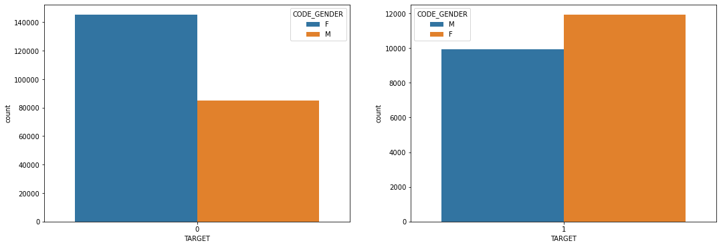
Segmented Analysis
The female count is more than that of male count in applicants
The percentage of male defaulters are more than that of male non-defaulters

Slide 16
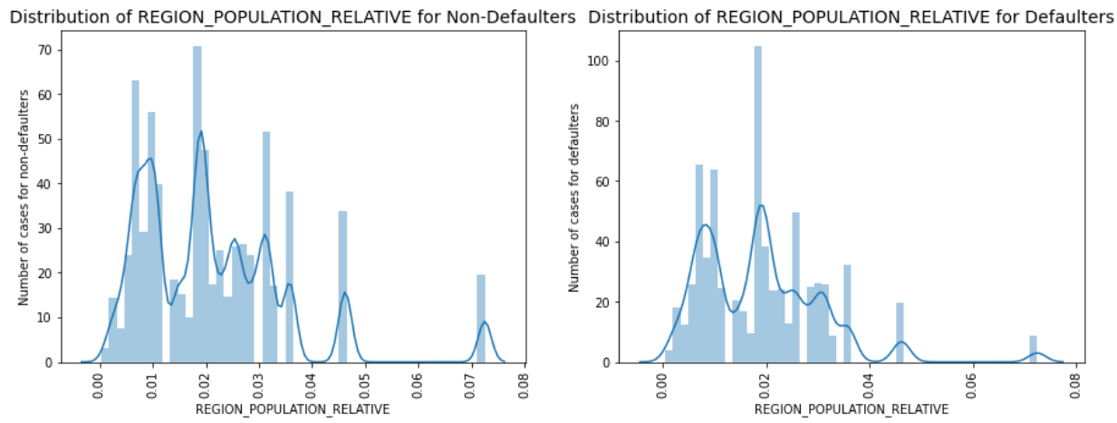
Univariate Analysis – Continuous Variables
REGION_POPULATION_RELATIVE :
The population relative more with respect to the no-defaulters
The distribution is more for defaulters having region population 0.02

Slide 17
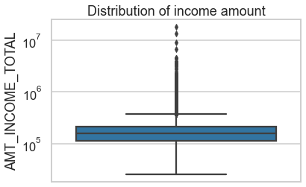
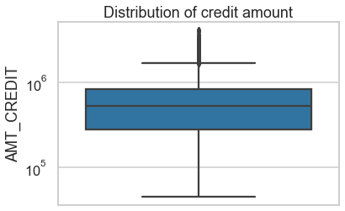
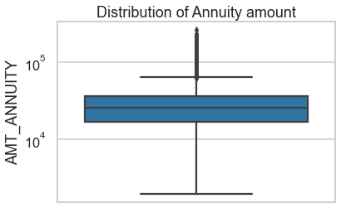
Outliers Detection for Target-0
Amt Income Total:
There are some outliers in the income amount column.
The third quartiles is very slim for income amount.
Amt Credit:
The column contains some outliers.
The first quartile is bigger than third quartile for credit amount which means most of the credits of clients are present in the first quartile
Amt Annuity:
Some outliers are noticed in annuity amount.
The first quartile is bigger than third quartile for annuity amount which means most of the annuity clients are from first quartile.

Slide 18
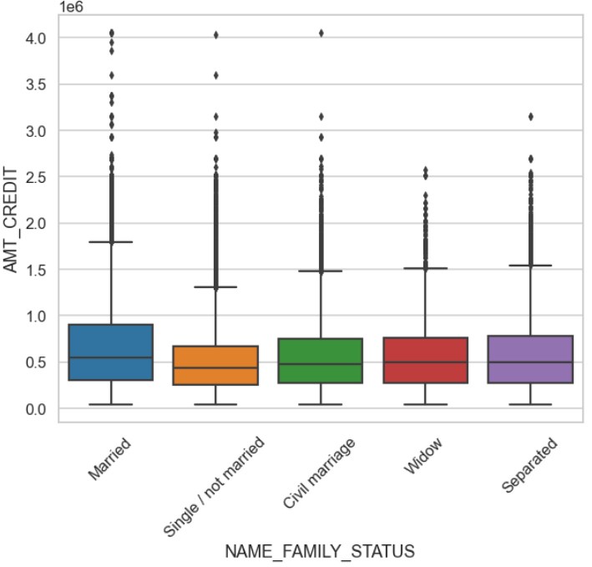
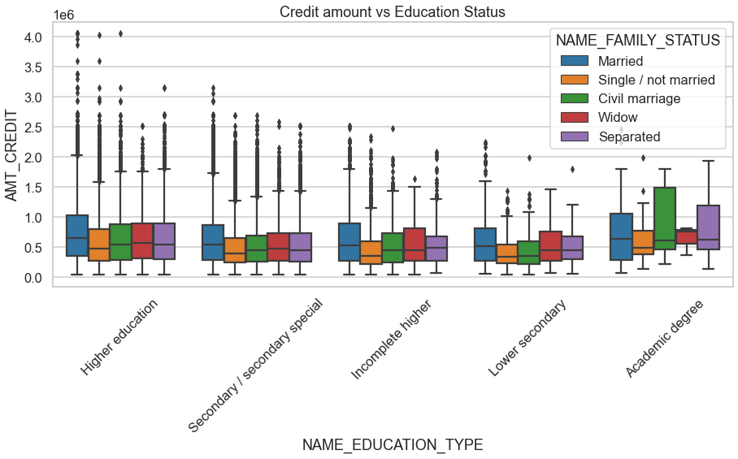
Bi-variate Analysis for Target 0
AMT_CREDIT & NAME_FAMILY_STATUS
Applicants with Family Status as “Married” have higher credit amount of the loan.
The second quartile for family status as “Marriage” is larger as compared to other family statuses.
Outliers are present in all the statuses.
AMT_CREDIT & NAME_EDUCATION_TYPE
Family status of 'civil marriage', 'marriage' and 'separated' of Academic degree education are having higher number of credits than others.
Also, higher education of family status of 'marriage', 'single' and 'civil marriage' are having more outliers.
Civil marriage for Academic degree is having most of the credits in the third quartile.

Slide 19
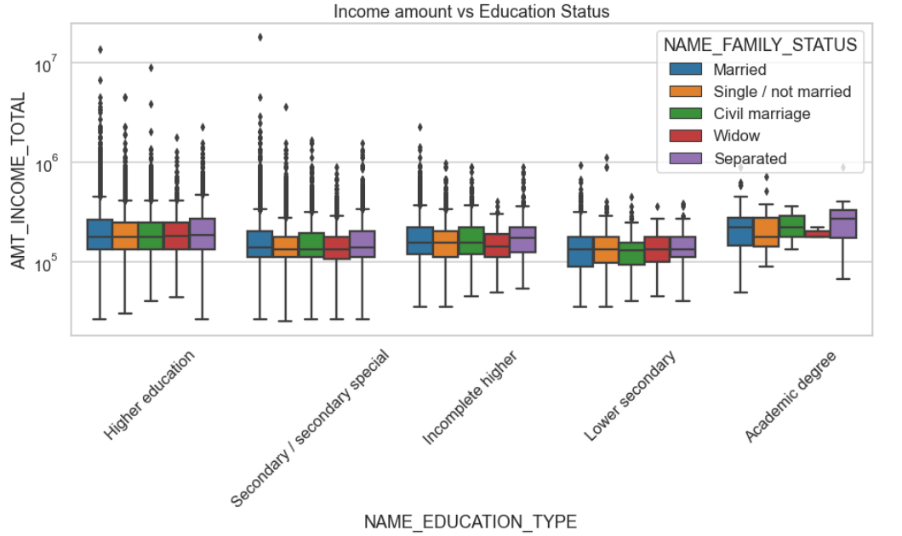
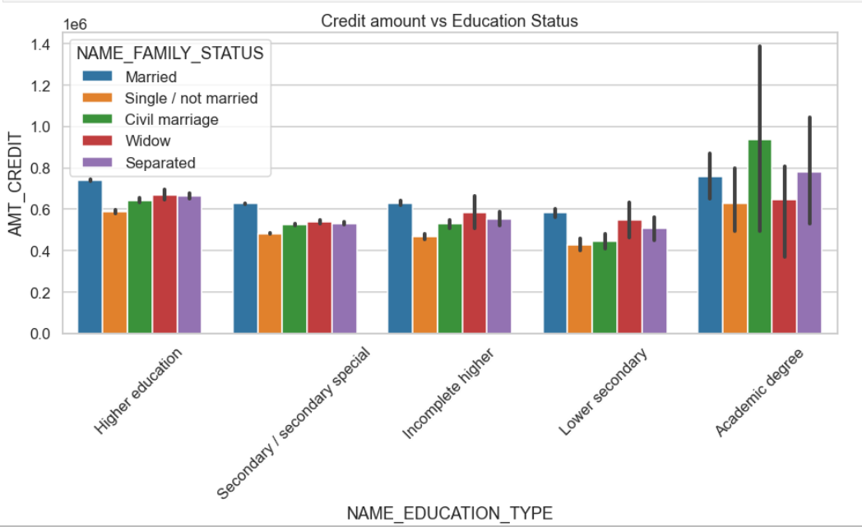
Bi-variate Analysis for Target 0 (contd..)
AMT_INCOME_TOTAL & NAME_EDUCATION_TYPE
For Education type 'Higher education' the income amount is almost equal with the family status. It contains outliers.
Less outliers are there for applicants with Academic degree, but their income amount is little higher that Higher education.
Lower secondary of civil marriage family status are having" less income amount than others.
AMT_CREDIT & NAME_EDUCATION_TYPE
Amount of credit is high in case of Higher education and Academic degree populations married persons took more credit than others.
Amount of credit is minimum for the populations having lower secondary education and all type of family status

Slide 20
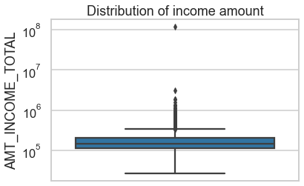
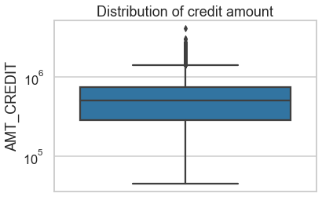
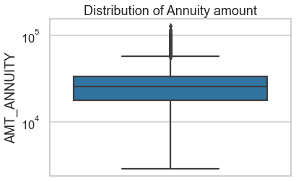
Outliers for TARGET-1
AMT INCOME TOTAL:
Some outliers are noticed in income amount.
The third quartiles is very slim for income amount.
Most of the clients of income are present in first quartile
AMT CREDIT:
Some outliers are noticed in credit amount.
The first quartile is bigger than third quartile for credit amount which means most of the credits of clients are present in the first quartile.
AMT ANNUITY:
Some outliers are noticed in annuity amount.
The first quartile is bigger than third quartile for annuity amount which means most of the annuity clients are from first quartile.

Slide 21
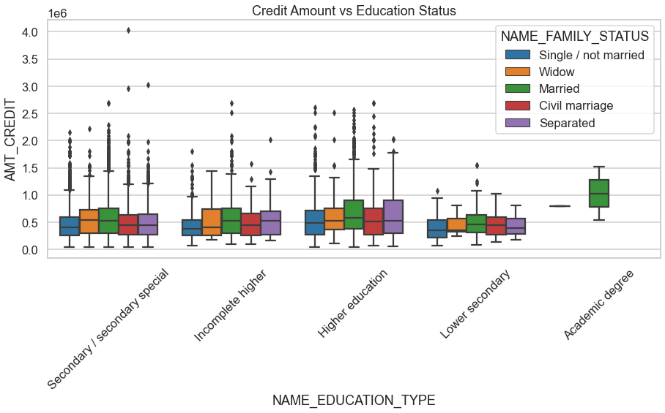
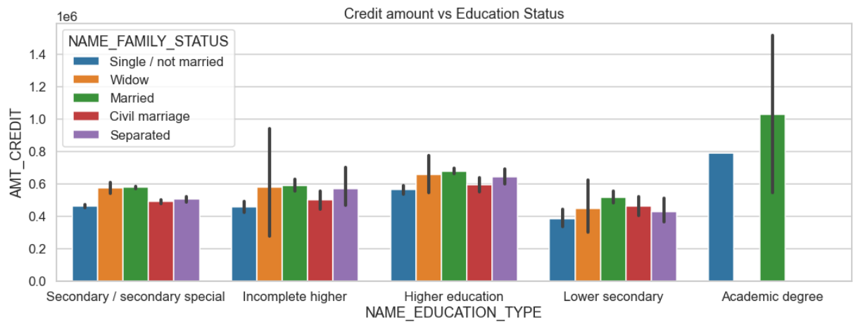
CREDIT AMOUNT VS EDUCATION STATUS
Bi-variate Analysis for Target 1
In all the section of education Status married people have taken more credits.
For Academic degree section data of only married people is available and don't have any outliers.
Most outliers are from Secondary special , incomplete higher and higher education.
AMT_CREDIT & NAME_EDUCATION_TYPE
Married people have high amount credit irrespective of the education types.
Lower Secondary have less credit amount than the others.

Slide 22
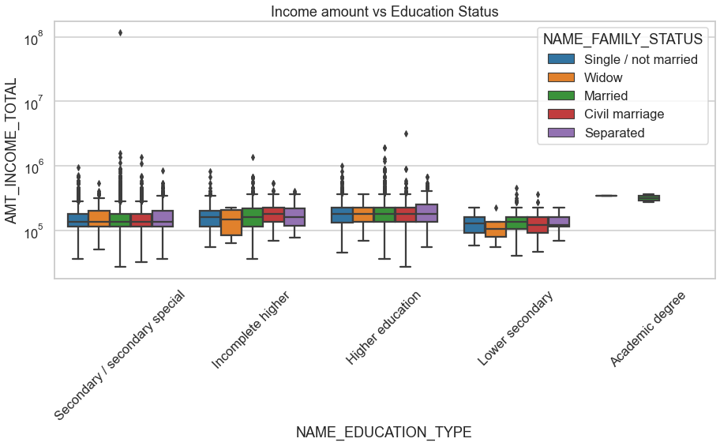
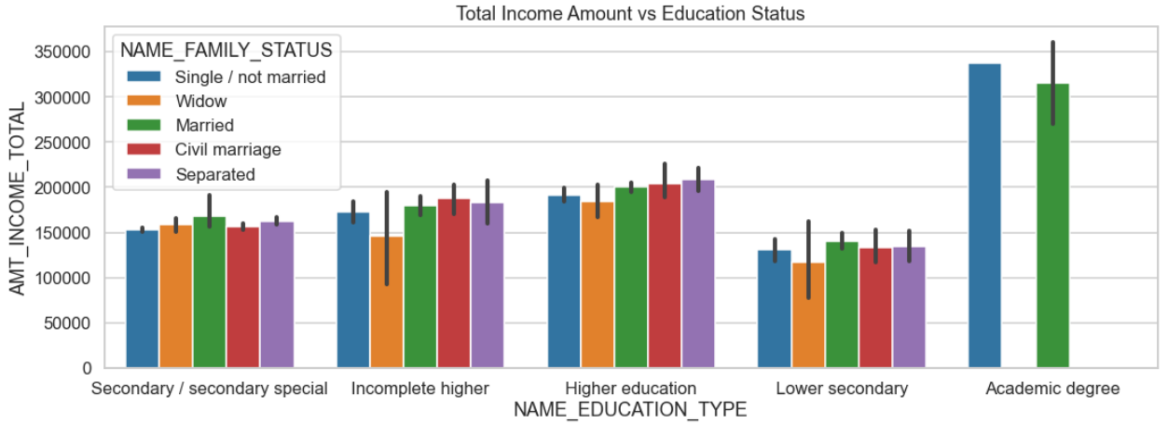
INCOME ANOUNT vs EDUCATION STATUS
Bi-variate Analysis for Target 1(contd..)
Married Category has greater number of outliers in all the education categories and having more values in the first quartile.
Lower secondary have less income amount than others.
AMT_INCOME_TOTAL & NAME_EDUCATION_TYPE
Married and single/not married Category is having Academic Degree have highest amount of income in total
Lower secondary have less income amount than others.

Slide 23
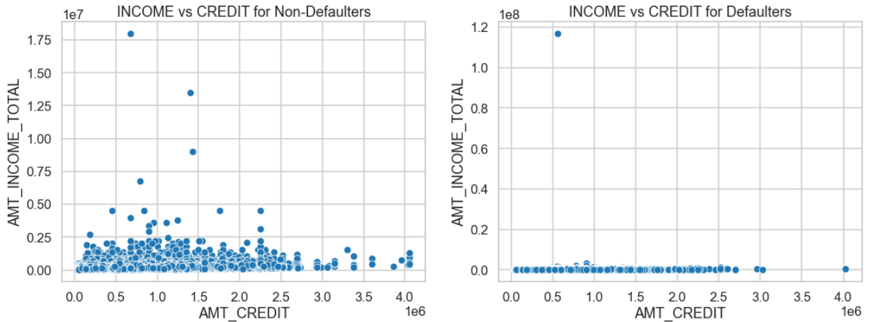
Bivariate Analysis - Defaulters and Non-Defaulters
The non-defaulters took more credit as compared to their incomes.
Defaulters have more amount of credit but their income is not high enough so its risky to give credit to the defaulters.

Slide 24
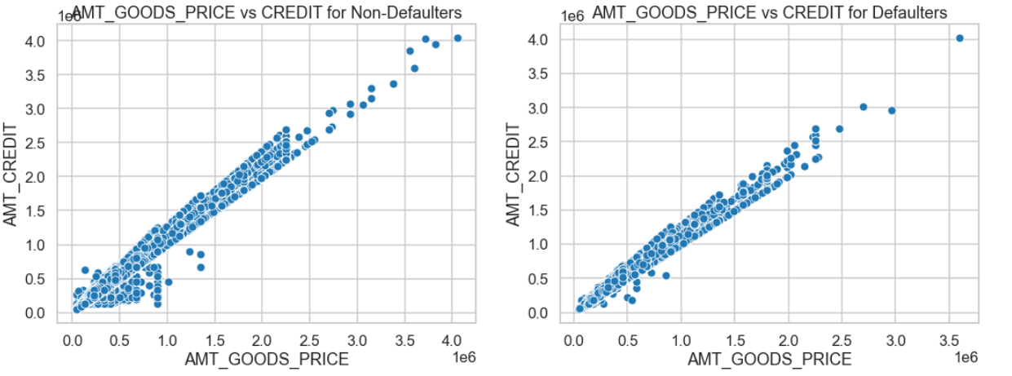
Bivariate Analysis - Defaulters and Non-Defaulters
Defaulters are less if price of good is upto 500k and amount credit is also less than 500k
Non-Defaulters the density is high when the amount goods is upto 1000k and the amount credit is upto 1000k

Slide 25
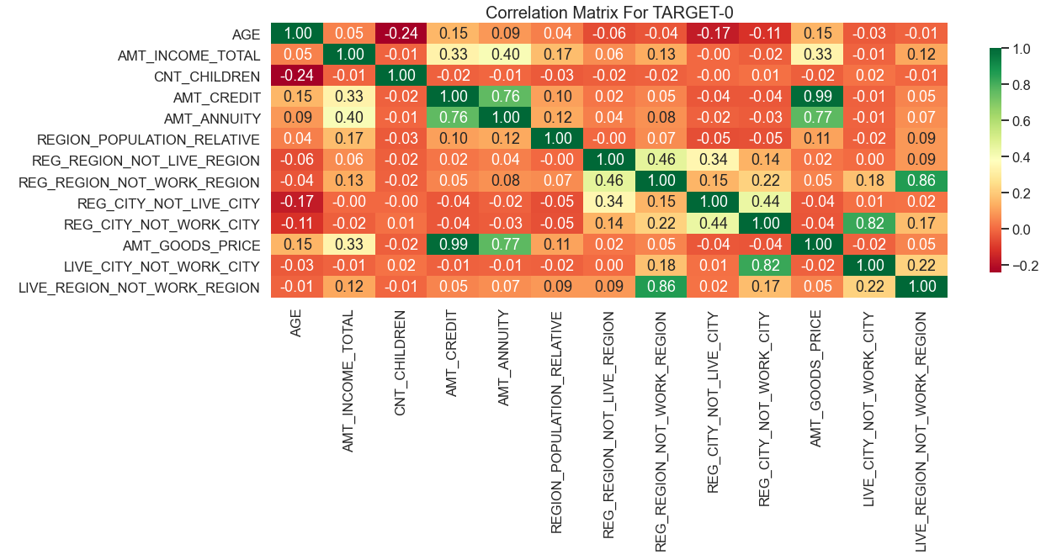
HEAT MAP/Correlation Matrix (TARGET 0)
Credit amount is inversely proportional to the date of birth, which means Credit amount is higher for low age and vice-versa.
Income amount is inversely proportional to the number of children client have, means more income for less children client have and vice-versa.
Credit amount is inversely proportional to the number of children client have, means Credit amount is higher for less children count client have and vice-versa.
clients have less children in densely populated area.
Credit amount is higher to densely populated area.
The income is also higher in densely populated area.

Slide 26
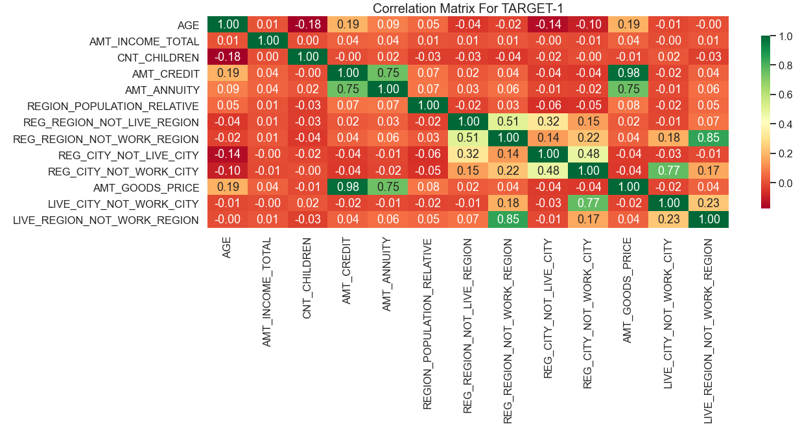
HEAT MAP/Correlation Matrix For TARGET 1
Most of the observations are same as of target-0 correlation heat map, but few new points observed.
The client's permanent address does not match contact address are having less children and vice-versa.
The client's permanent address does not match work address are having less children and vice-versa.

Slide 27
Previous Application Data
Previous application data frame is created using the file previous_application.csv.
The data was inspected using the shape, info & column functions.
The columns were checked for missing values. Columns with more than 50% missing values were removed
Columns containing values like ‘XNA’, ‘XAP’ were dropped.
A new data frame is created by combining the application_data and previous_application data.
Columns were renamed and unwanted columns were dropped.

Slide 28
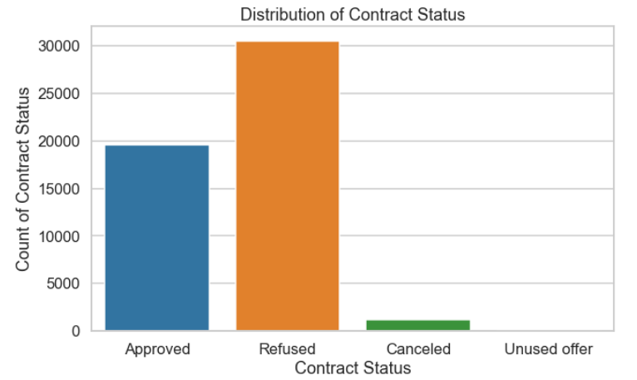
Univariate Analysis
The number of refused applications is
quite high.

Slide 29
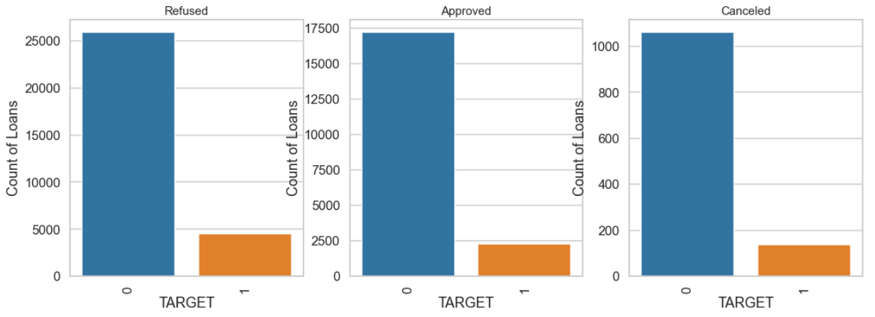
Univariate Analysis
Diving the data set into four categories based on the contract status. We have the below observations:
The ratio of defaulter's vs the non-defaulters in all the statuses is almost the same.

Slide 30
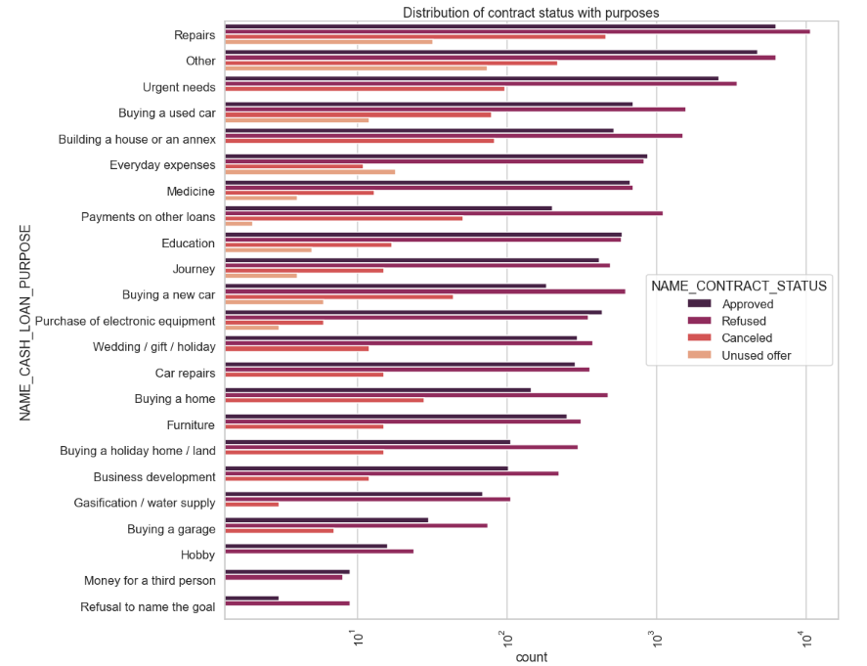
Univariate Analysis – Contract Status & Cash Loan Purpose
Distribution of contract status with purposes
Most rejection of loans came from purpose 'repairs’.
For Medicine purposes we have equal number of approvals and rejection.
'Payments on other loans', 'buying a new car' and 'buying a home' has significantly higher rejection than approvals
Only 'Money for a third person', 'Purchase of electronic equipment' and 'Education’ has higher loan approval than rejections.

Slide 31
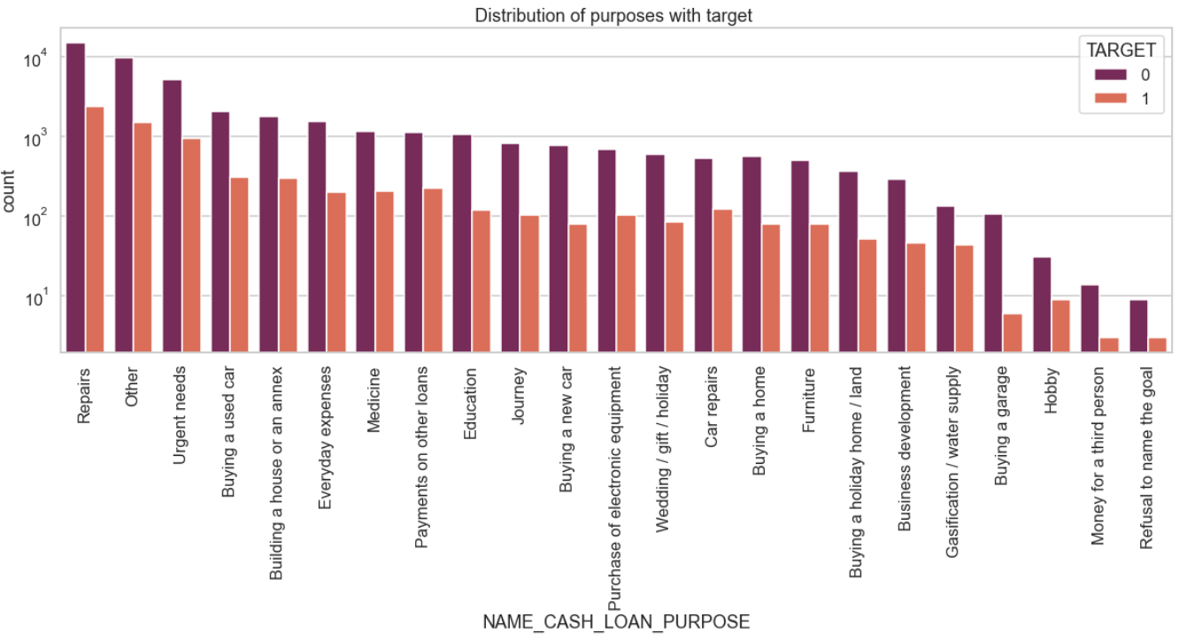
Univariate Analysis – Cash Loan Purpose & Target
Distribution of purposes with target
Loan purposes with 'Repairs' are facing more difficulties in payment on time.
There are few places where loan payment is significantly higher than facing difficulties. They are 'Refusal to the name goal’, 'Money for a third person', 'Buying a garage'. Hence, we can focus on the purposes for which the client has minimal payment difficulties.

Slide 32
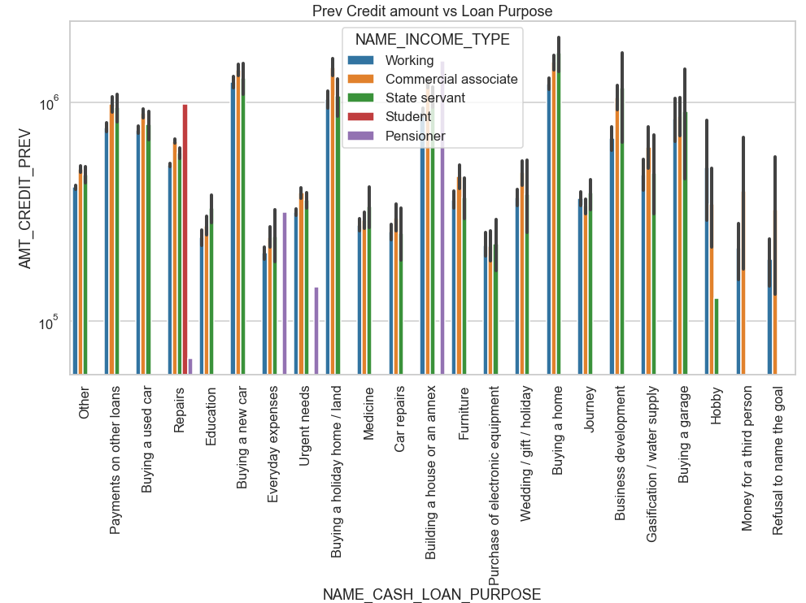
Bi-variate Analysis – Previous Credit Amount vs Loan purpose
Prev Credit Amount vs Loan purpose
The credit amount of Loan purposes like 'Buying a home’, 'Buying a land’, 'Buying a new car' and ‘ Building a house' is higher.
Income type of state servants have a significant amount of credit applied
‘Purchase of electronic equipment', 'Hobby', 'Refusal to the name the goal', 'Everyday expenses' is having less credits applied for.

Slide 33
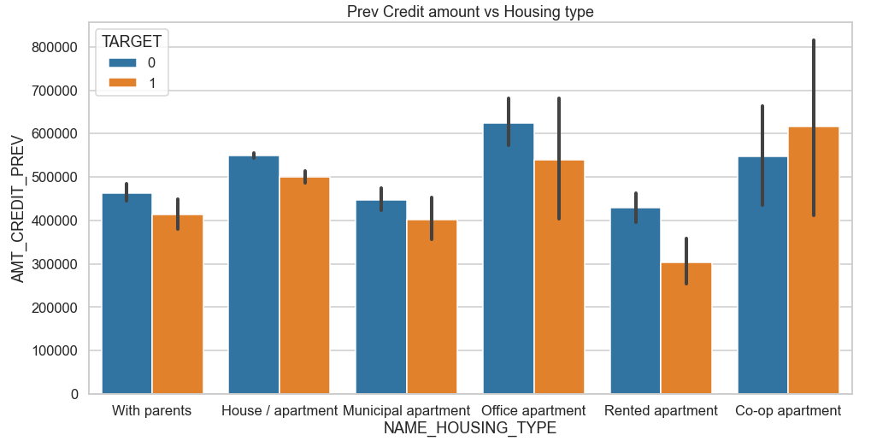
Bi-variate Analysis
Previous Credit Amount vs Housing Type
Housing Tppe as "office appartment" have higher credit for target 0.
Co-op apartment has higher credit for target 1.
So, we can conclude that the bank should avoid giving loans to the housing type of co-op apartment as they have payment difficulties.
Bank can focus mostly on housing type with parents or House\appartment or municipal appartment for successful payments.

Slide 34
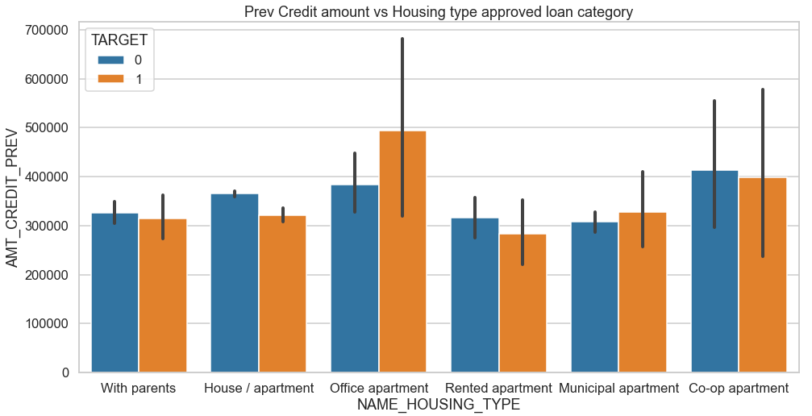
Bi-variate Analysis
Previous Credit amount vs Housing type Approved loan category
Clients having office appartment have higher approved rate but must of their payments are unsucessful, so bank should not approve such loan categories.

Slide 35
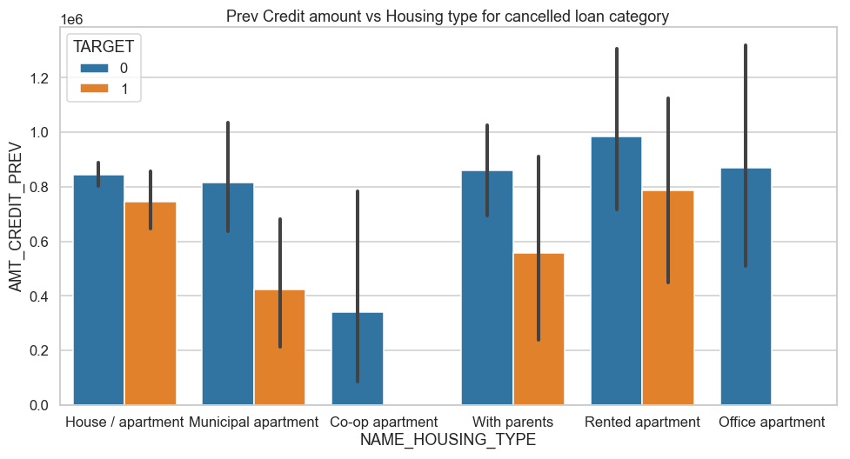
Bi-variate Analysis
Previous Credit amount vs Housing type for Rejected loan category
Bank should refuse the loan application of clients having housing type "co-op apartment" as they have more defaults.
Previous Credit amount vs Housing type for cancelled loan category
Bank should target clients having housing type "with parents" as more no. of applications got cancelled from this section, but they are most successful payment clients

Slide 36
Conclusion
Banks should focus more on customers with contract type ‘Student’ ,’pensioner’ and ‘Businessman’ with housing ‘type other than ‘Co-op apartment’ for successful payments.
There are less loan applications from customers having high salary and no repayment issues.
Banks should focus less on customers with income type as ‘Working’ as they have a greater number of unsuccessful payments.
Customers with loan purpose as "Repair" have higher number of unsuccessful payments.
Get as much as clients with housing type as ‘With parents’ as they are having least number of unsuccessful payments.
The customers whose applications were previously approved and have housing type as office apartment seem to have a greater number of unsuccessful payments.
Bank should not reject the applicants having housing type 'house/apartment’, 'muncipal apartment’, 'with parents' as more successful payments achieved from these categories.

